Slide 1
Fourier transform with its application
pRESENTOR: XINCHEN HUA
INSTRUCTOR: WEIHAO ZHENG

Slide 2
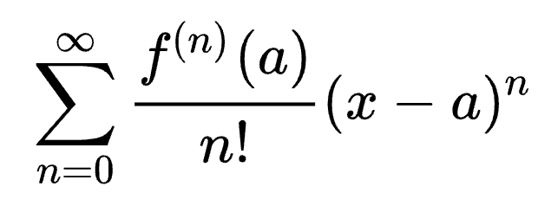
TEXTBOOK: FOURIER ANALYSIS, STEIN
Reading process:
Chapters: 1-6
Why do we need Fourier analysis?
In Taylor’s theorem, we can expand arbitrarily ”good” functions as the sum of polynomials,
. In Fourier analysis, by the same analogy, we want to expand functions as the sum of sin and cos!

Slide 3
“fourier transform” vs “taylor expansion”
1. ”Good” functions have a wide range of general functions that varied based on the functions. However, Fourier analysis only uses sin/cos functions, well-known and lots of good properties (ex. Periodic, continuous,…)
2. Sin and Cos functions have property of ocillation, making the phenomenoms more intensified than Taylor expansion.
3. By restraint of Taylor expansion, f should be belongs to class of c^♾️. But by Fourier transform, the functions are less depend on the “smoothness” and thus less restricted.

Slide 4
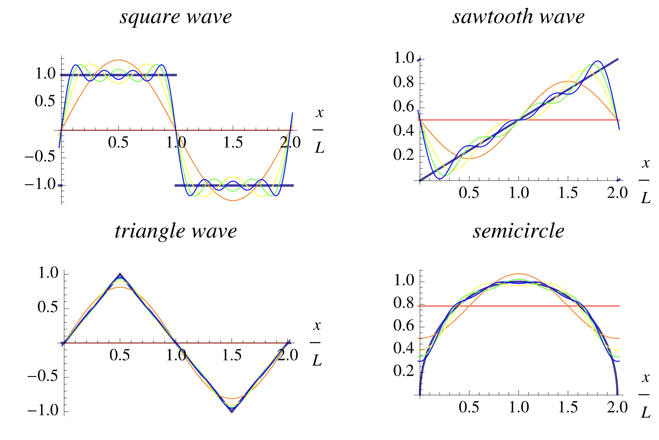
Why we need fourier transform
A tool for estimating equations and feedback images
A tool that can be used to restore images
A simplifying tool for complicated functions

Slide 5
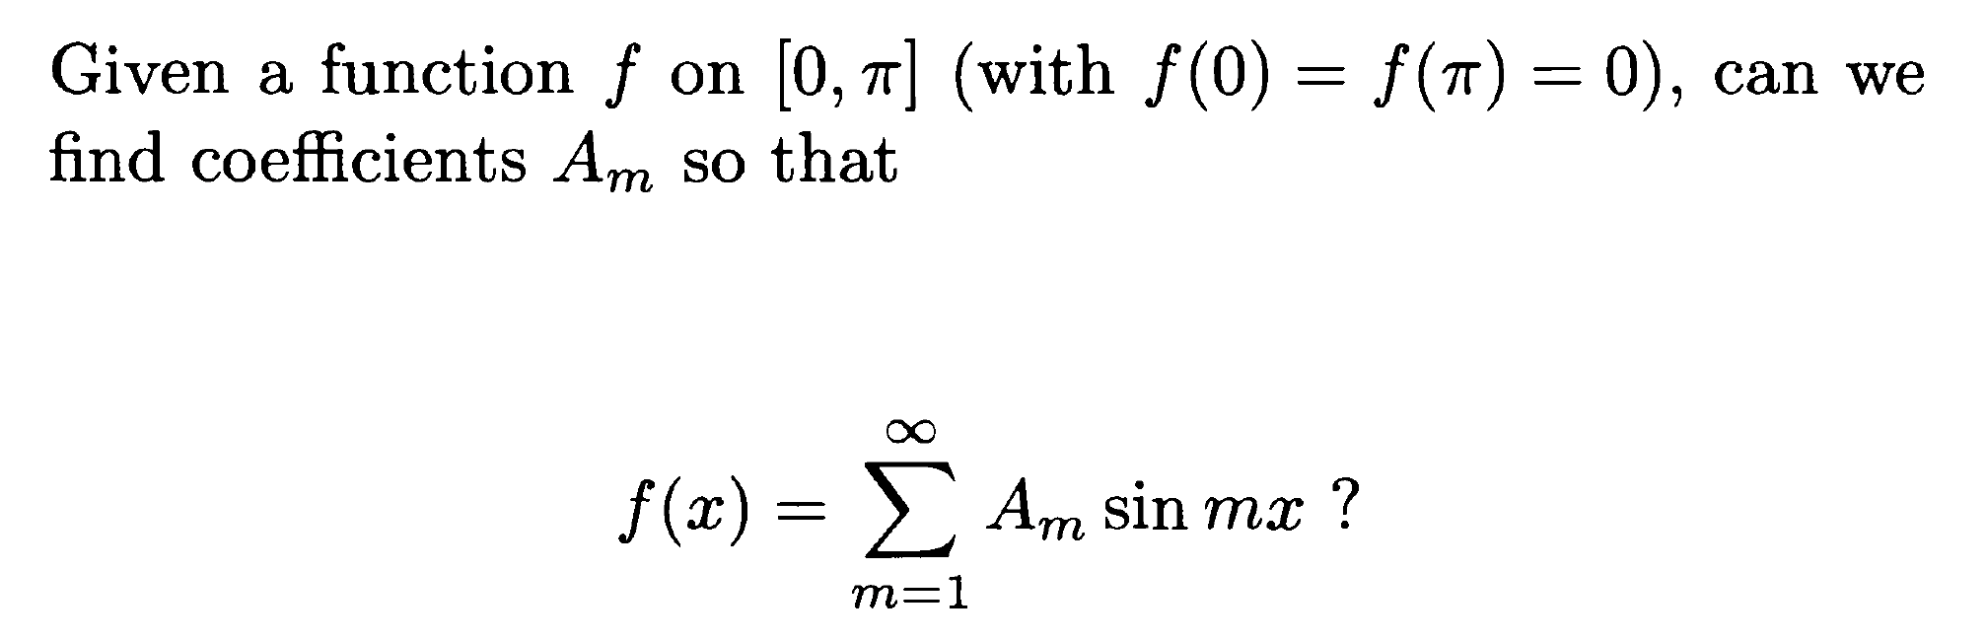
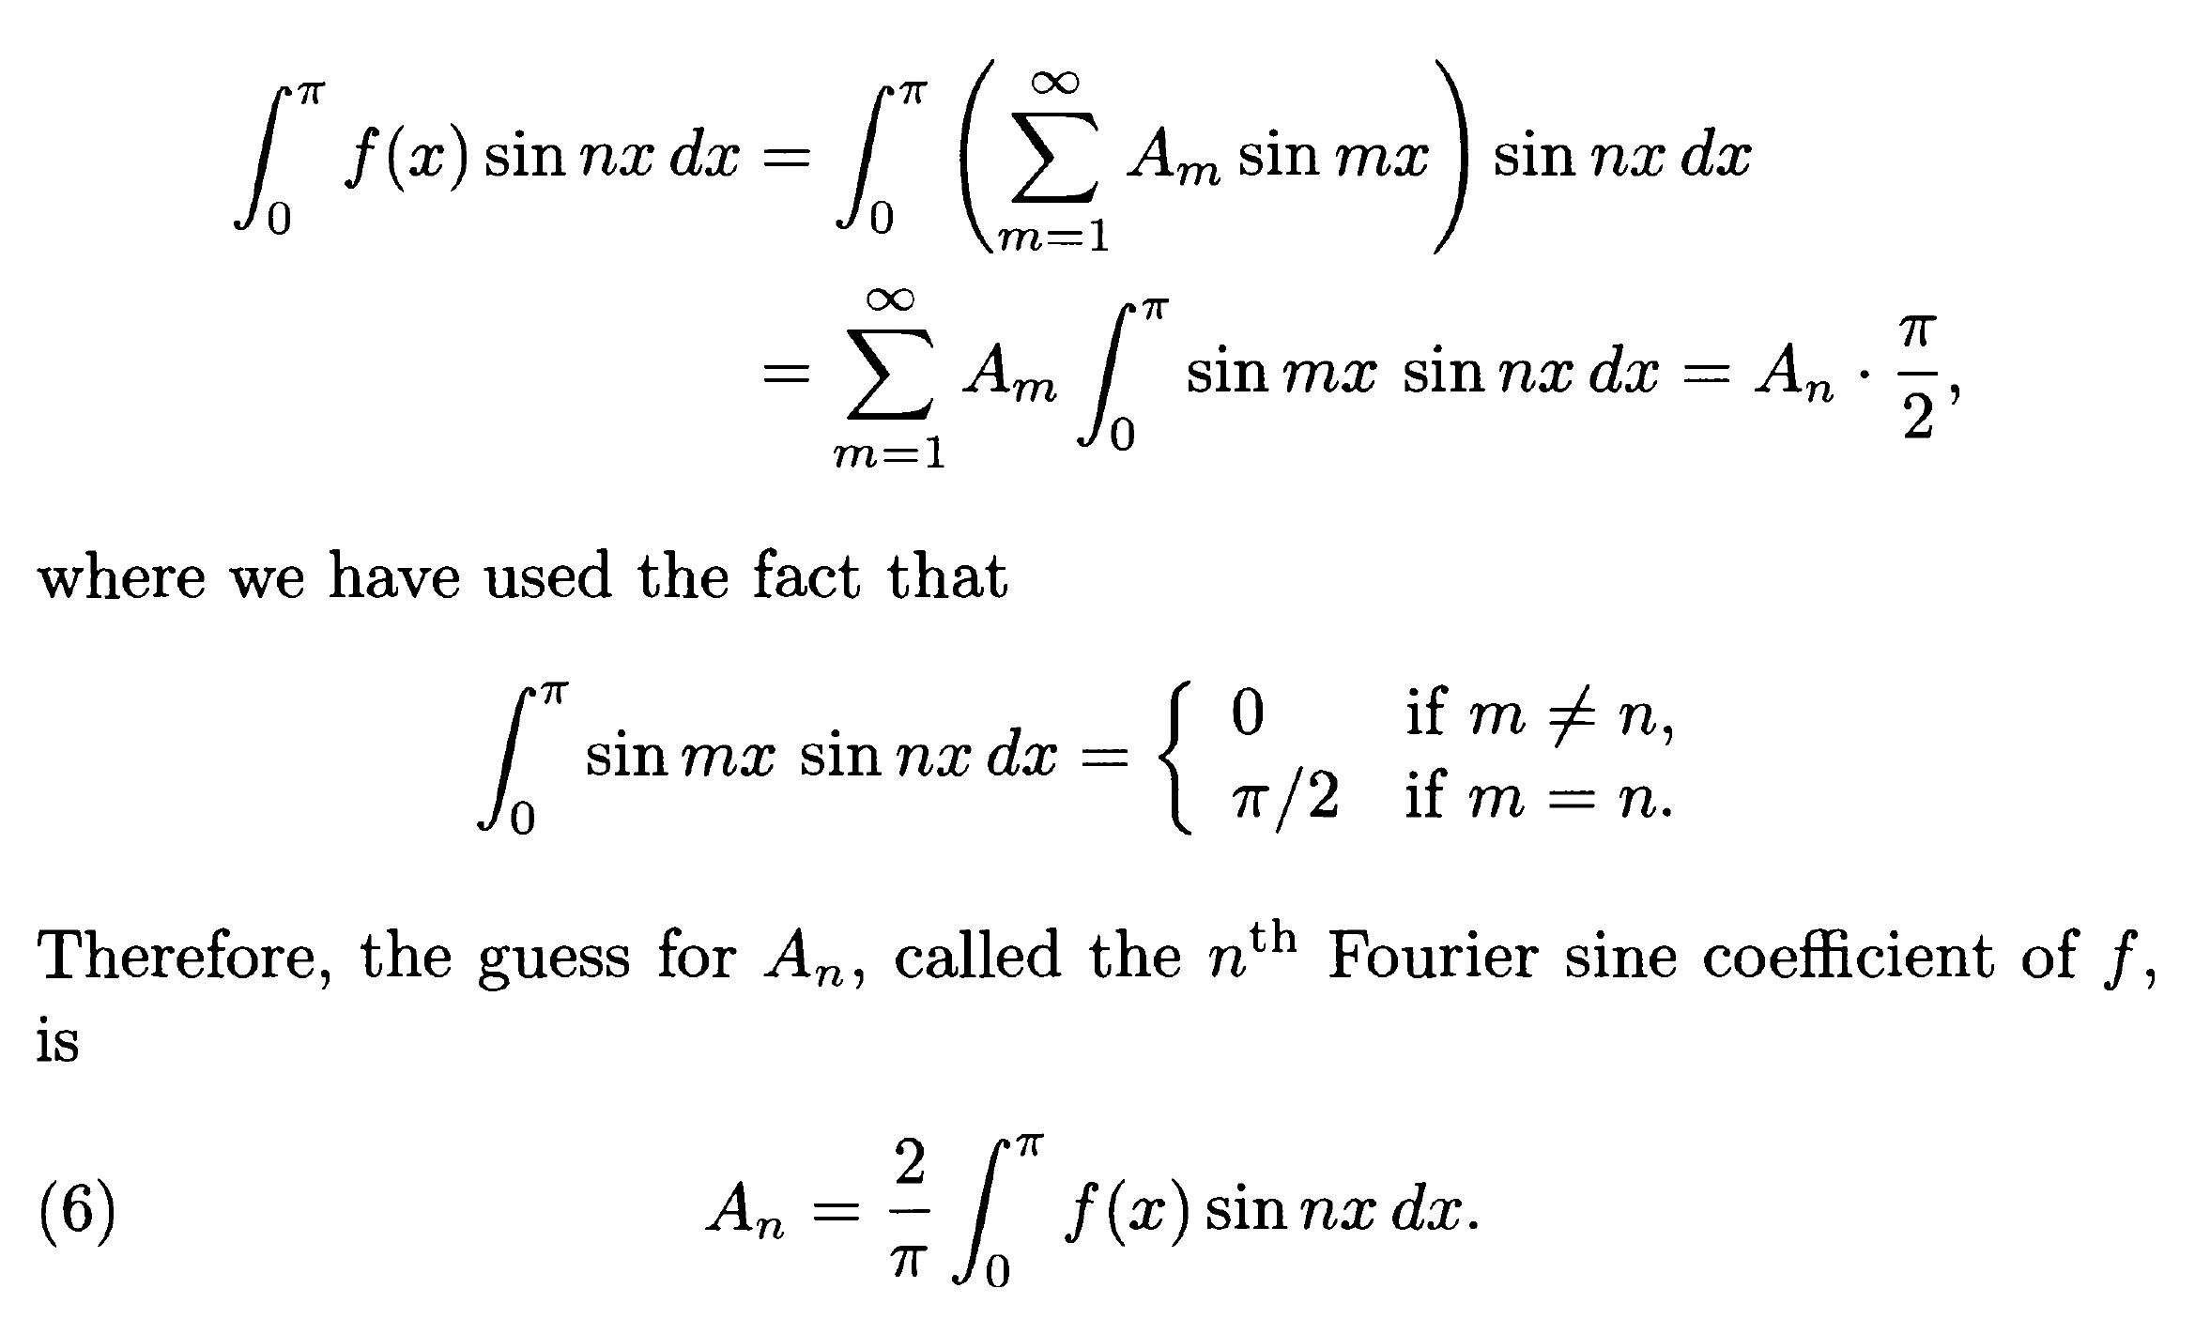
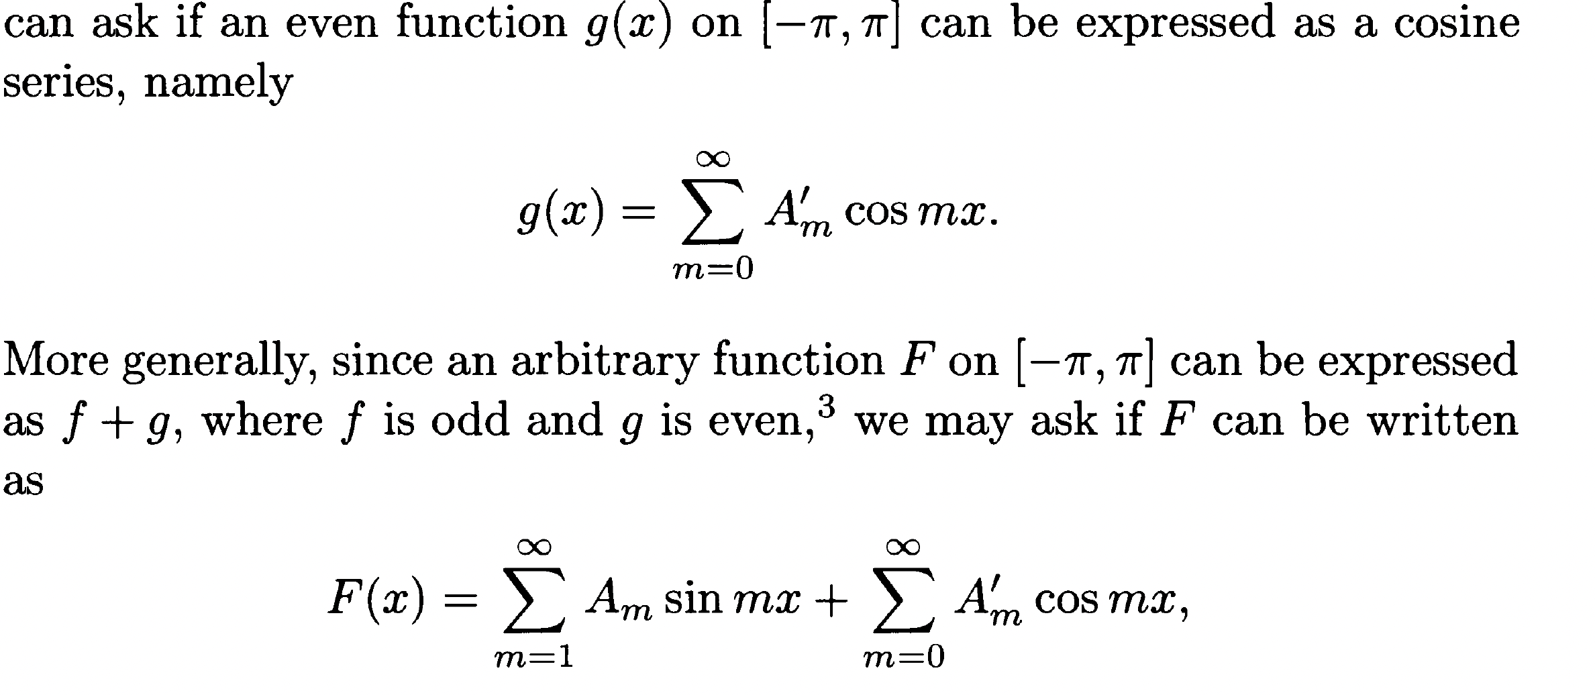
How this tool works

Slide 6
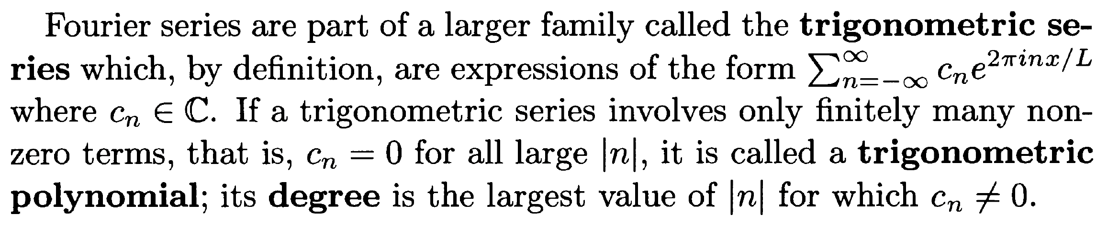
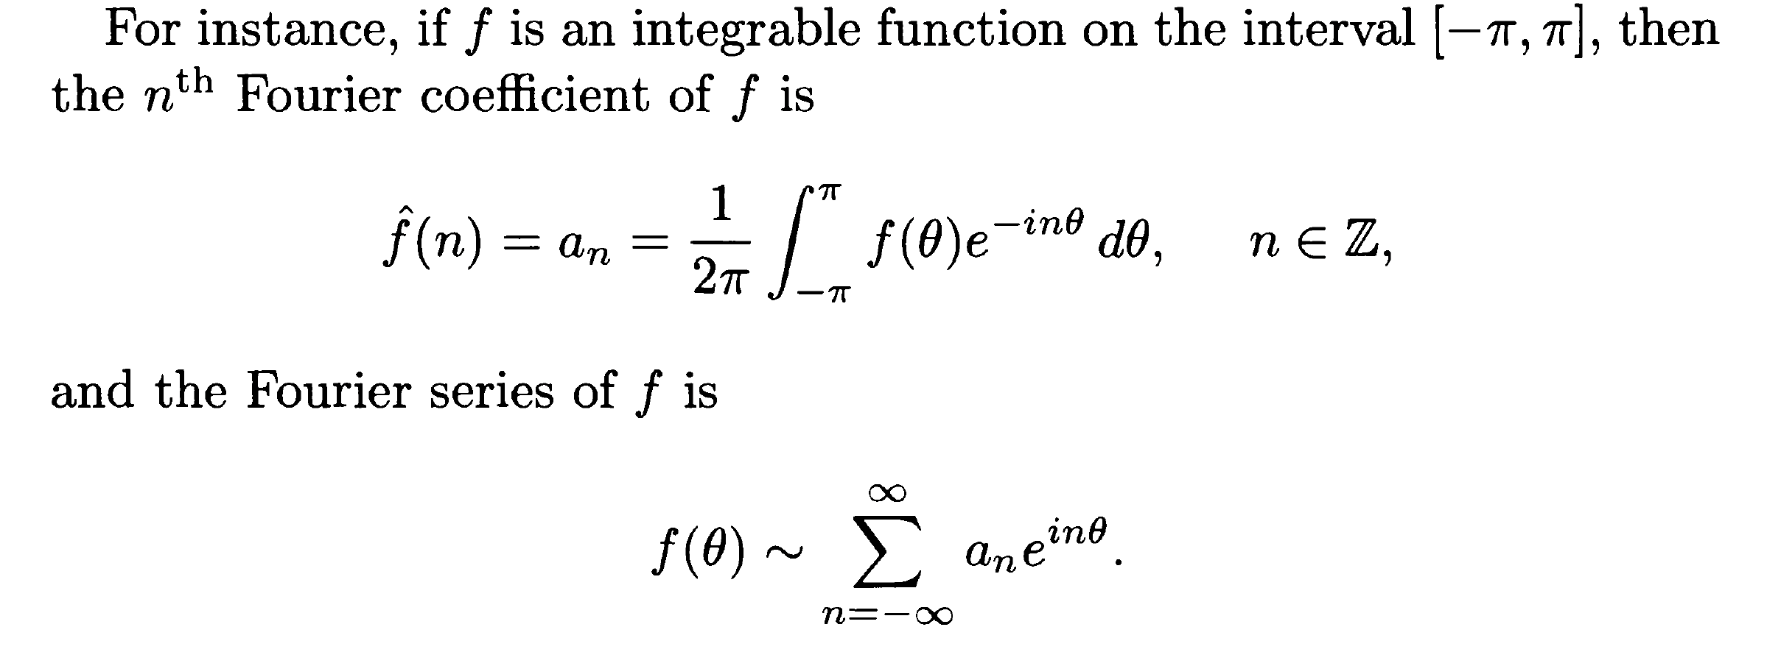
Definition and background

Slide 7
Natural q: Partial sum = Function?
Note:
1. It is natural to assume f is continuous, as the Riemann integrable is mainly based on partitions.
(i.e., we can change the integral function without changing Sn)
2. But, Is continuous property enough? Ans: Not always!

Slide 8
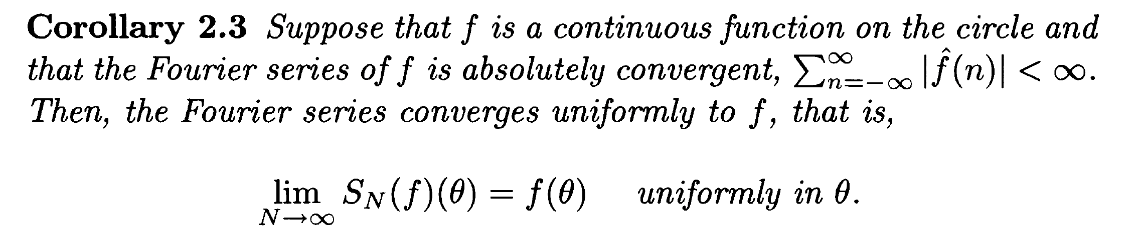
Continuity of functions
Note: For certain functions, continuity is enough, but what if its Fourier series diverges?

Slide 9
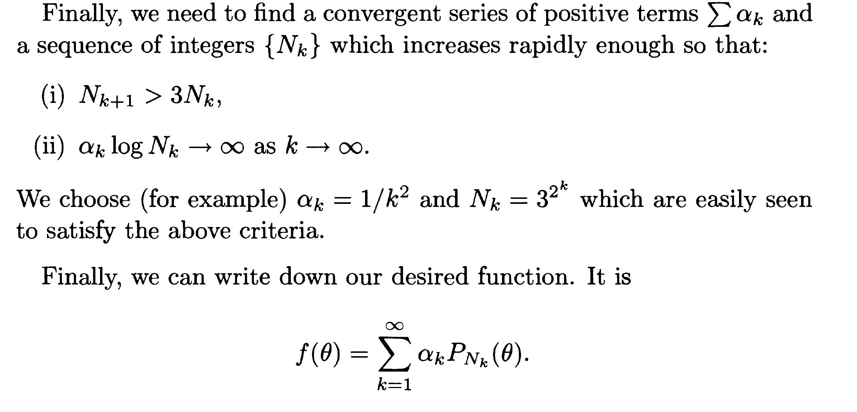
A continuous function with divergent fourier series

Slide 10
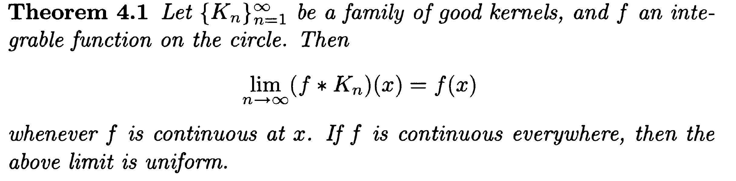
Some theorem

Slide 11
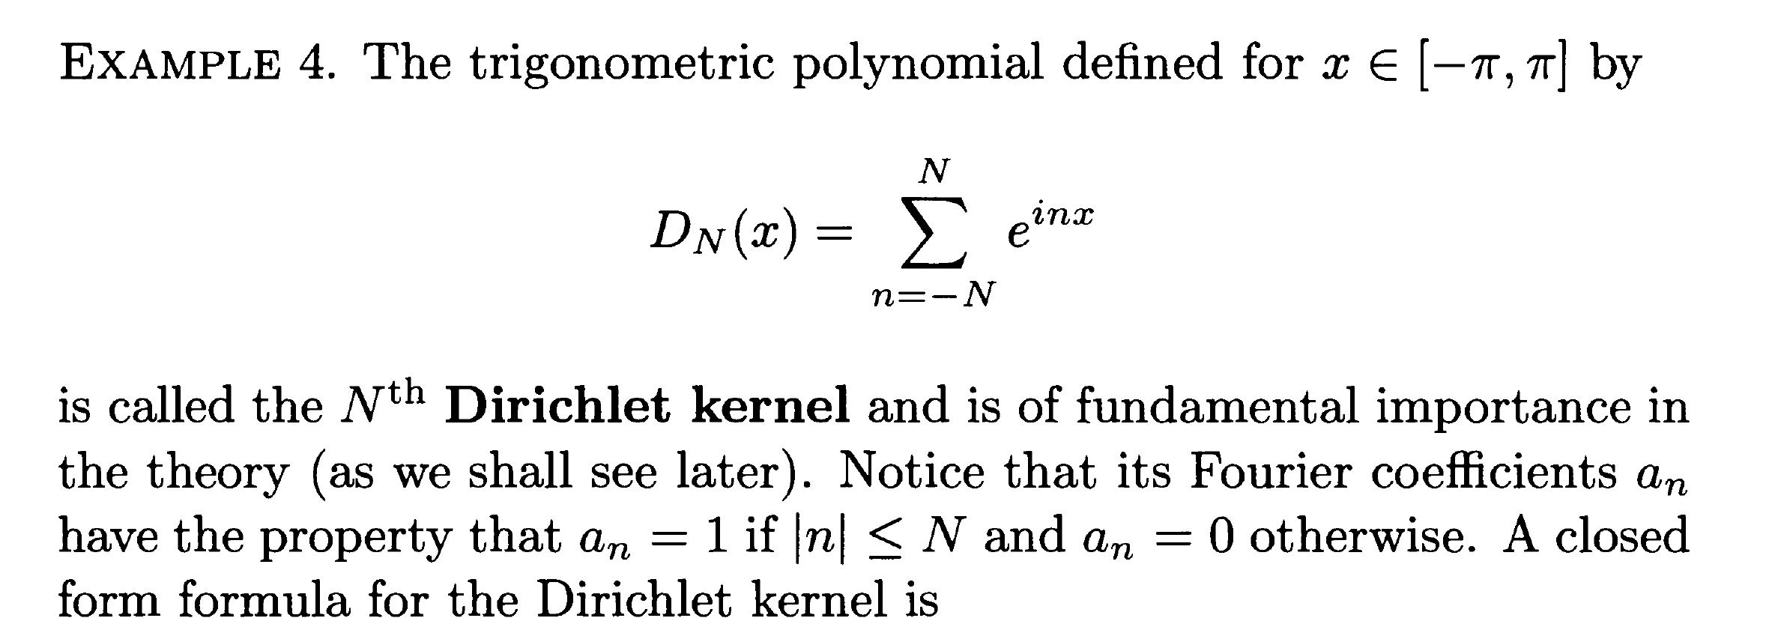
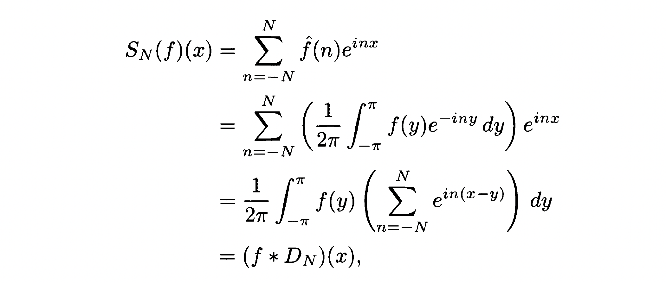
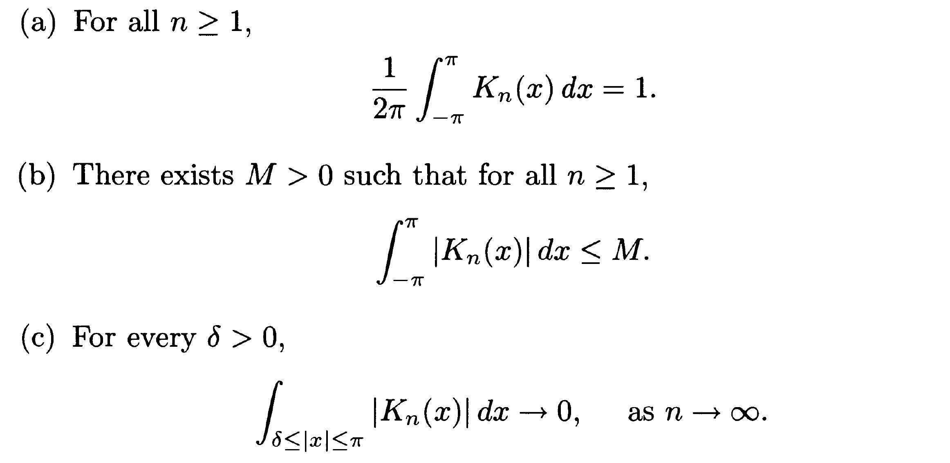
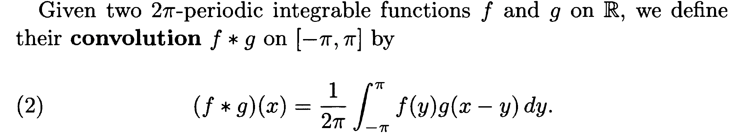
Easy approach: Special consideration and def
Dirichlet Kernel
Fourier series
Def for Good Kernel
Convolution
Note: No restriction on continuity! Integribility is enough!
“Major way to do approximation”

Slide 12
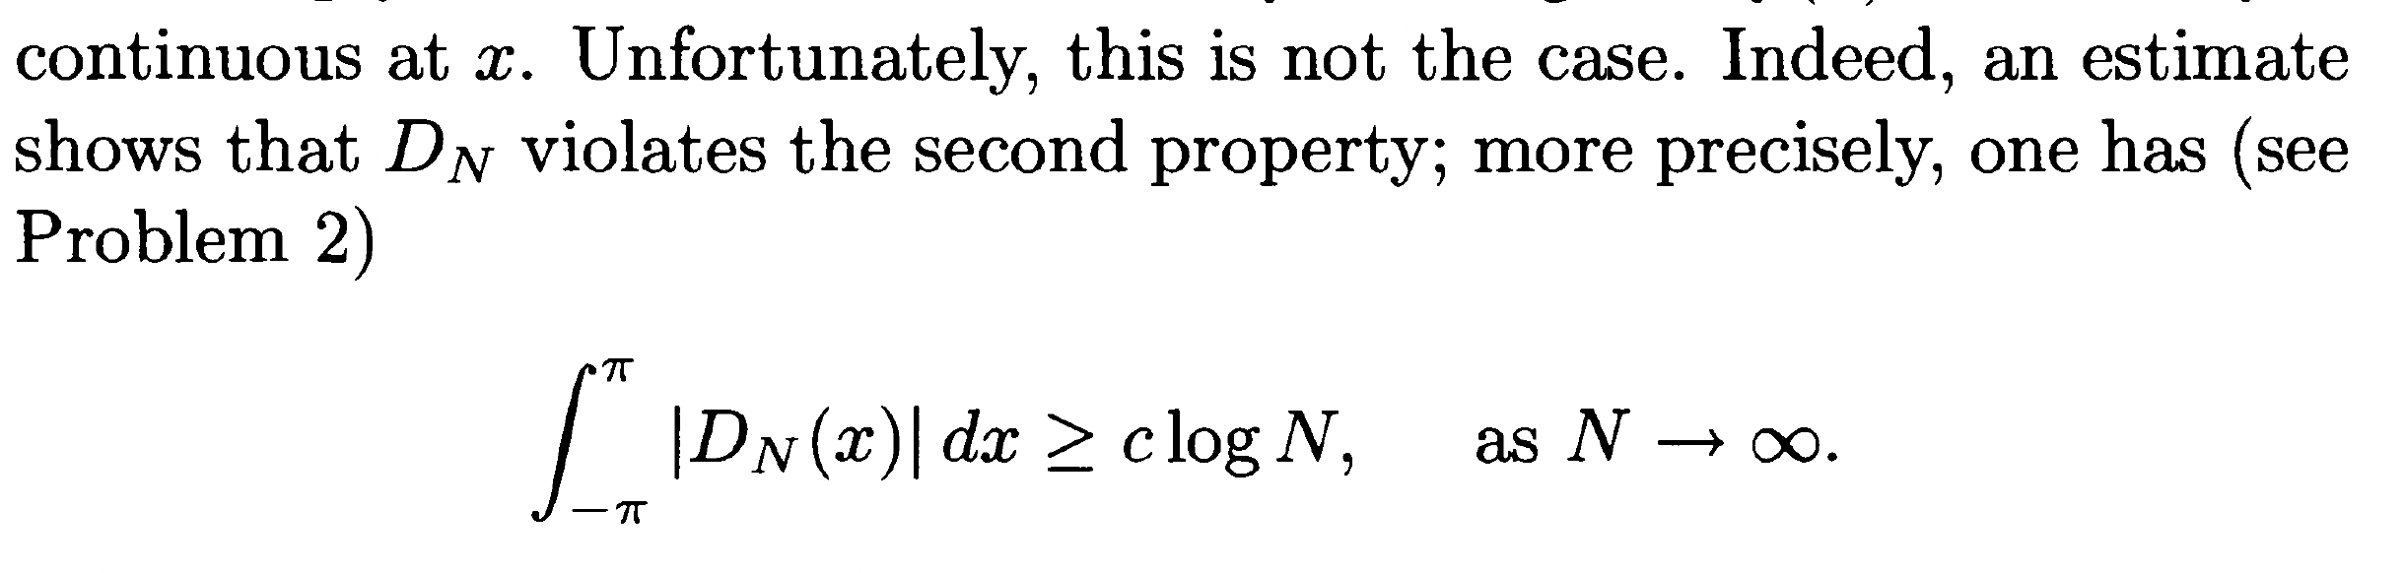
Logic: If DN(x) is good kernel and f is continue, then we are done.
However, Dirichlet Kernel is not a good kernel!
We need to pose more constraints on f(x)!

Slide 13
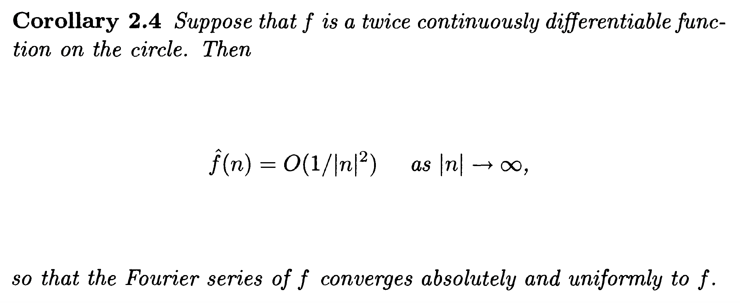
Different constrain on f(X)
Case 1: twice differential continues

Slide 14
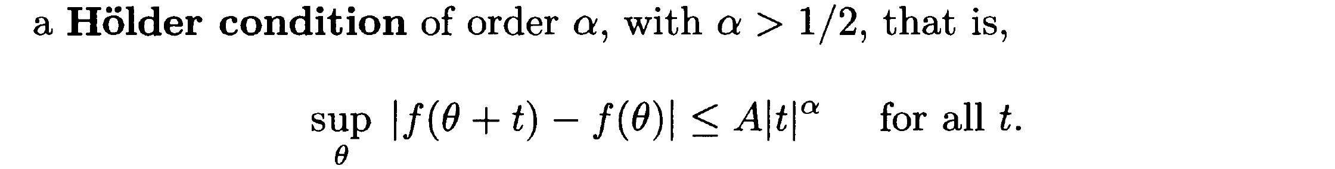
Different constrain on f(X)
Case II: Holder condition
The main idea of these two contraint, is to make the function “smooth”. (i.e., to make the function decay rapidly so that the Fourier coefficient can catch up with it)

Slide 15
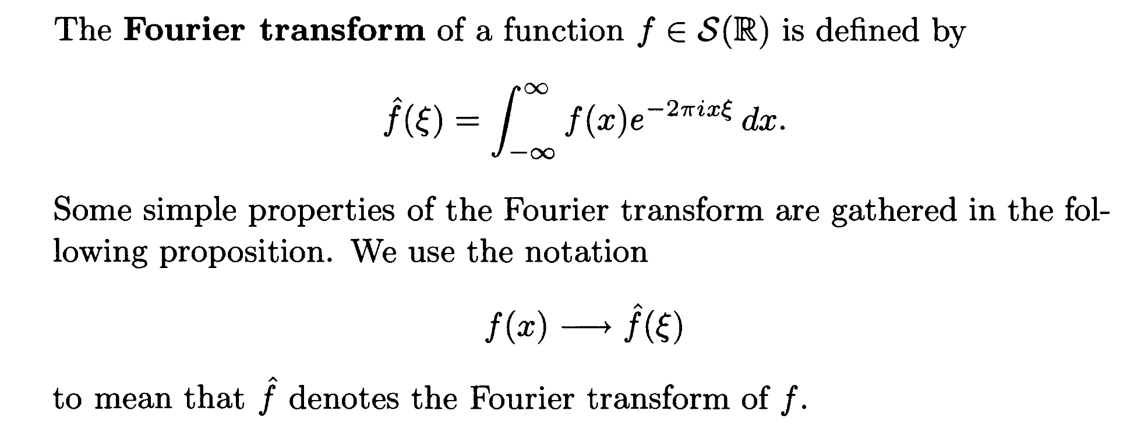
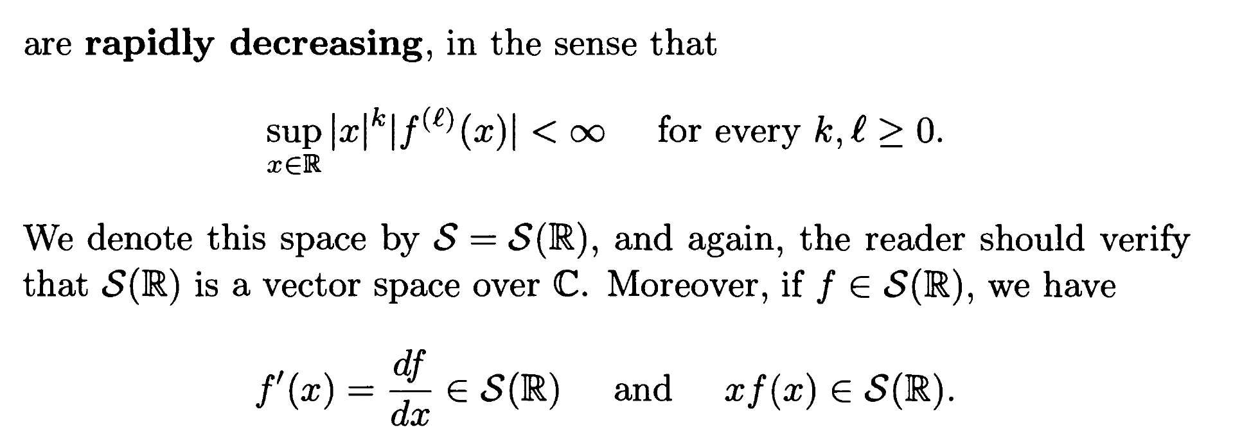
Extansion to the whole real line
Q: What if function is not periodic?
Ans: We can still use Fourier series to describe!
Note:
“Just as we discussed before, we still need our function to be smooth enough”

Slide 16
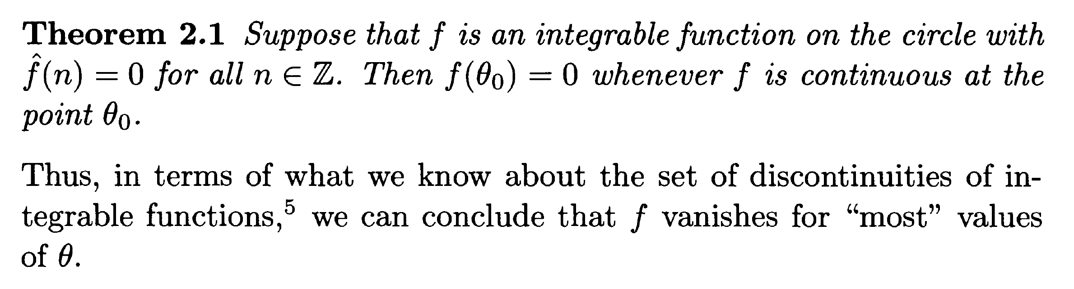
Example for how to analysis ”fouriersly”

Slide 17
Key idea and indicator
Main idea: Proof by Contradiction.
ie. If f not equal to 0 its continuity, then it can not have a Fourier coefficients equal to 0
Notable construction:
A trigonomtric family of peak index. (Magnifiers, to zoom in the behavior of function as 0)
Division for certain interval.

Slide 18
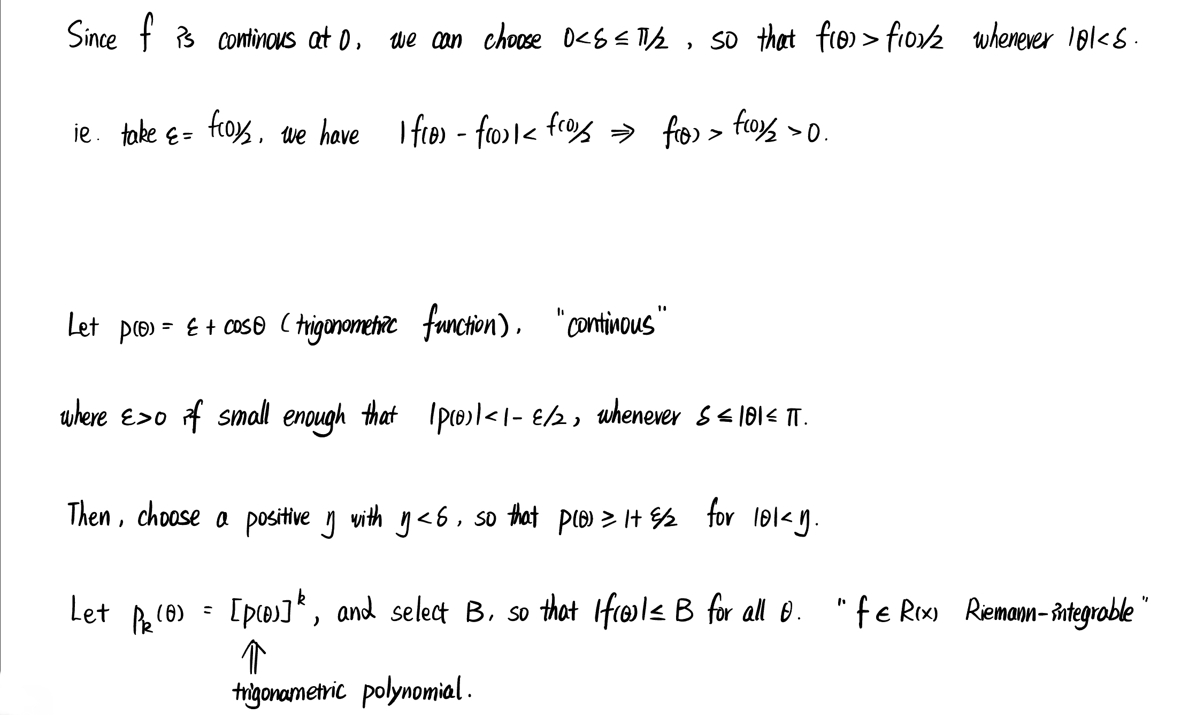
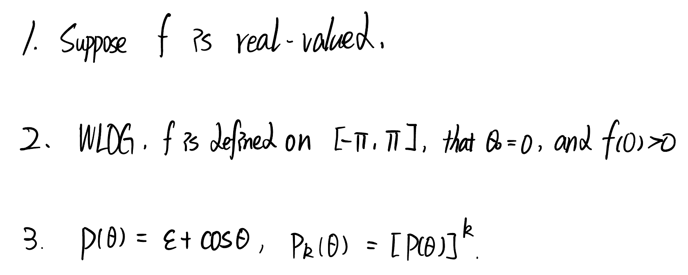
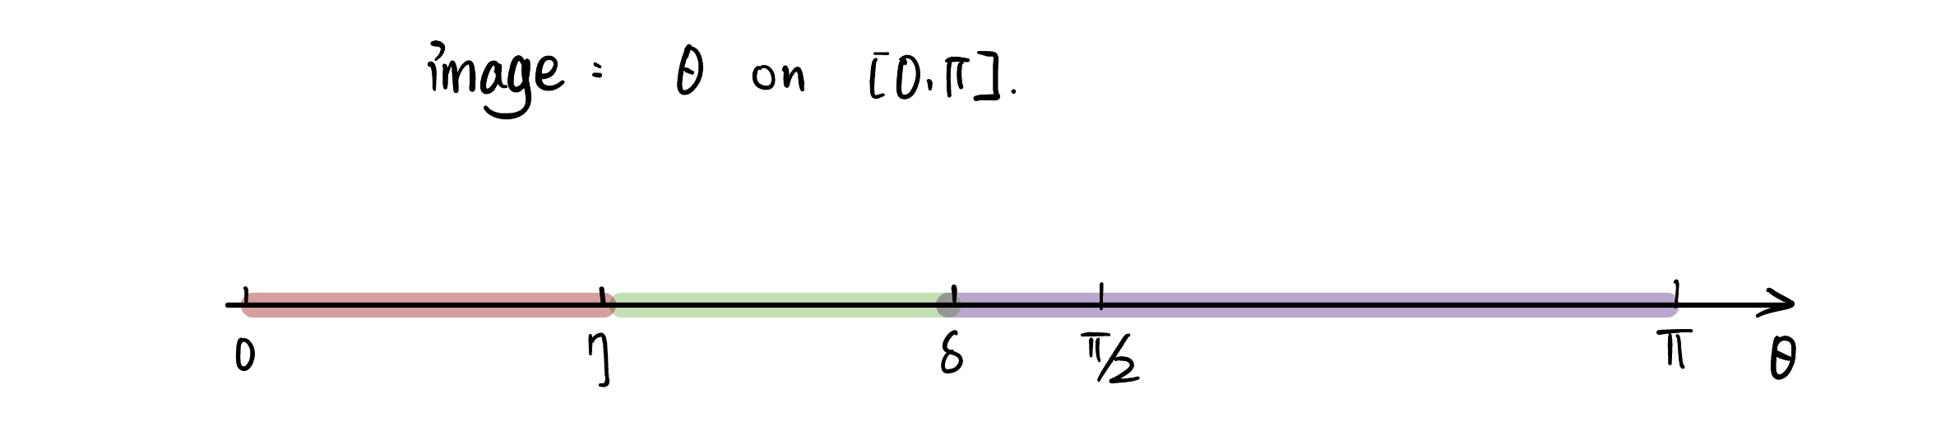
Function setting and peak construction

Slide 19
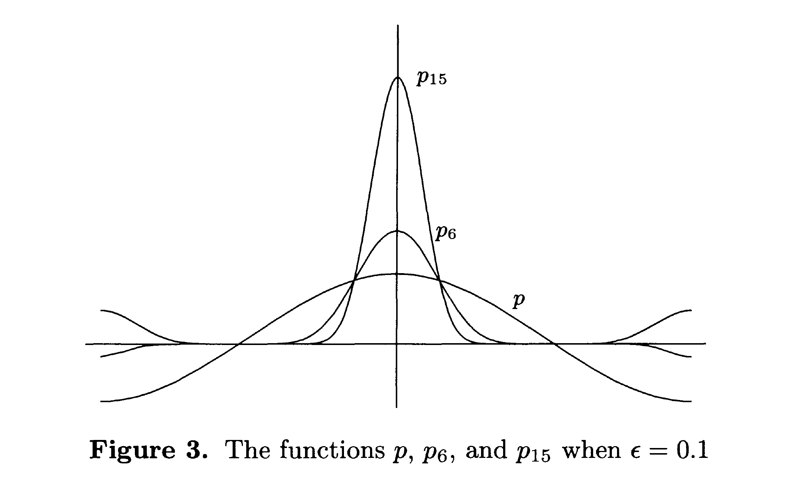
Example

Slide 20
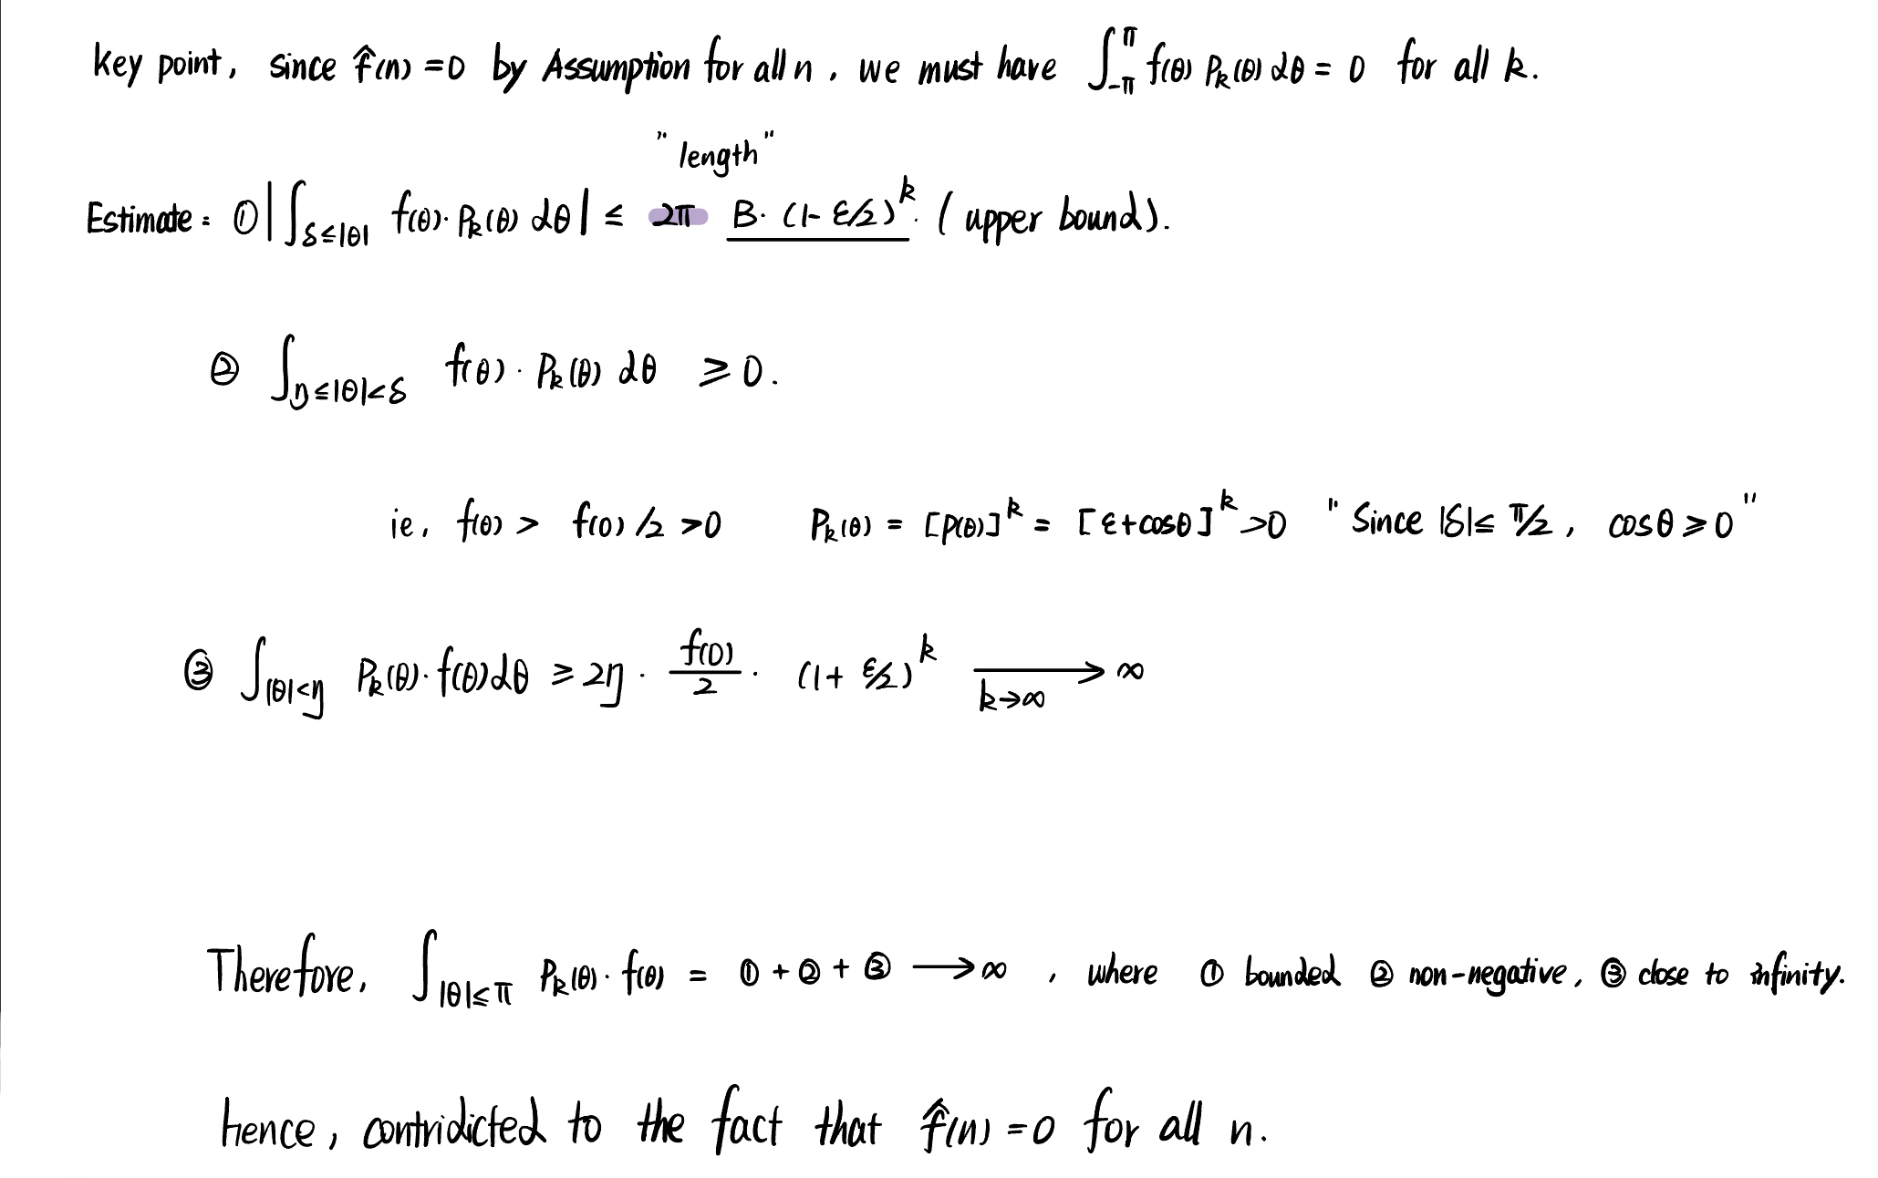
Analysis process/estimation

Slide 21
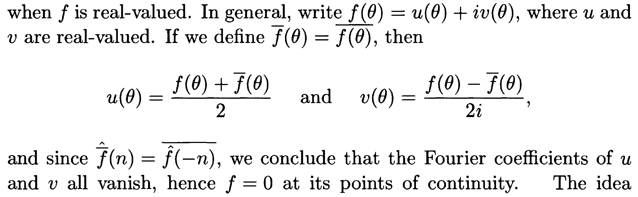
Extended to complex field

Slide 22
Thanks for your listening!!!
Many thanks to my instructor Weihao Zheng during this summer.

